Slide 1


PSYCH 251: Reproducibility Project
Arnes et al (2015): Frontal and rostral anterior cingulate (rACC) theta EEG in depression: Implications for treatment outcome?
Oscar D. Mier
M.S. Symbolic Systems Candidate at Stanford University
M.S. Neuroimaging and Informatics
B.S. Neuroscience

Slide 2


Why Should We Care
Problem
Depression is a leading cause of disability worldwide and is a significant contributor to the overall global burden of disease. Approximately 280 million people worldwide have depression (World Health Organization, 2022).
Depression disrupts daily function, and its effects can be long-lasting, yet there are no established physiological indicators that can be used to predict treatment outcomes (Chestnut et al., 2021).
Possible future Implications of neuroscience informed precision psychiatry
Limit the trial-and-error process in psychiatry. Maybe.
Get patients the right treatment right away.
Precision medicine is already being developed with similar imaging modalities, such as ECG in cardiology (Lyon et al., 2018).

Slide 3
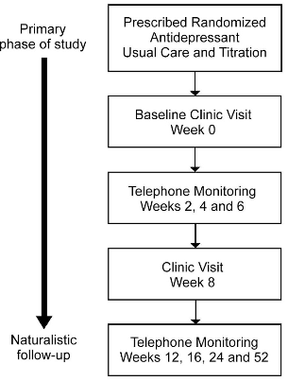
Methods
Resting-state eyes closed on a 26-channel gel EEG (Quikcap; NuAmps) and obtained Hamilton Rating Scale Scores for Depression (HRSD17) at two-time points (baseline and week-8 visit). The HRSD17 was obtained by trained clinicians who have passed inter-rater reliability training (Williams et al., 2011).
Source localization of theta wave density with eLORETA software at the rACC. eLORETA was tested under multiple computer-controlled conditions and with human EEG recordings under diverse stimulations conditions to validate its source localization method (Pascual et al., 2011).
But, EEG has poor spatial resolution, and it is recommended to have at least 64 channels for EEG source localization.
no mention of correcting for multiple comparisons in the paper.
Fpz channel is important in localizing ACC activity, but this channel was not included in this study.
Fig 3: Summary of iSPOT-D monitoring of participants (Williams et al., 2011).
Notes:
Horizontal and vertical eye movement electrodes are placed near the eyes to remove artefacts. In the original paper, it says eyes closed, but in Williams et al, 2011, it says eyes open.

Slide 4
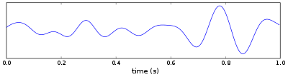
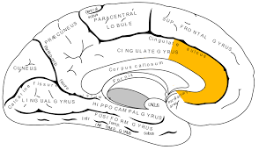
Study design
Hypothesis
phasic (not continuous) theta (rACC) density is associated with an improved treatment outcome in patients with MDD.
International multi-center (20 sites) and phase-IV clinical trial to Predict Optimized Treatment - in Depression (iSPOT-D) (Williams et al., 2011)
Fig 1: Theta Wave. MicroVolts over time graph. Theta wave is 6.5 – 8.5 Hz (cycles) per second. (Walter and Dovey, 1944). EEG stands for electroencephalogram.
Participants were randomized into three treatment groups in a 1:1:1 ratio (Will only focus on two groups for this reproduction project):
Sertaline (SSRI): Selective serotonin reuptake inhibitor.
N = 336 at baseline visit. N = 251at timepoint 2 (week-8 visit)
Venlafaxine XR (SNRI): Extended-Release Serotonin-norepinephrine reuptake inhibitor.
N = 336 at baseline visit. N = 235 at timepoint 2 (week-8 visit)
Causal inferences assumptions
The rACC is a critical node in the depression network from deep brain stimulation study (Mayberg et al., 2005). EEG recordings and HSRD17 are each based on well-established constructs in the literature (Alexandre et al., 2013; Williams et al., 2011; haMILTON, 1960)
Fig 2: The region of interest (ROI) is the rostral Anterior Cingulate Cortex (rACC). Few studies investigating depression found increased theta to be localized within the rACC (Jaworska et al., 2012; Korb et al., 2008). In line with other imaging modalities (fMRI) (Pizzagalli et al.,2011)).

Slide 5
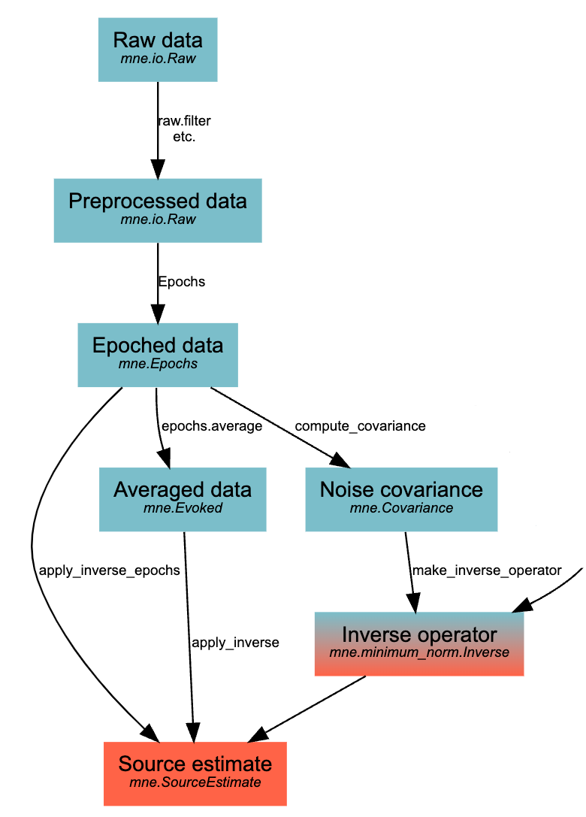
Analytic Pipeline
Data is contained in a cloud system. I will use a cluster network to analyze large data sets.
The programming language is Python.
Python library is MNE which contains the eLORETA algorithm for free.
Original study cost ~ $ 20 million. So far, my reproduction study has cost me $ 0.
Fig 3: Typical EEG workflow of MNE software on python (Alexandre et al., 2013) .

Slide 6
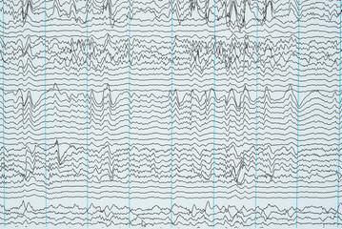
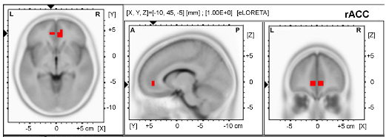
Results and Key Analysis of Interest
[1] The primary research outcome is treatment response:
defined as a ≥50% decrease from the baseline HRSD₁₇.
[2] Secondary outcomes include remission of MDD:
defined as a score of ≤7 on the HRSD₁₇.
Significant correlations were found between HRSD17 scores for treatment response and rACC theta waves at the 8-week time point for the SNRI (P = 0.21; r = 0.093, and DF = 608) as well as between percentage improvements on HRSD17 and rACC (p = .049; r = 0.80; DF = 608)
Fig 4: Example of raw EEG signals from multiple channels.
Theta measures were log-transformed before statistical analysis.
ANOVA was conducted with a within-subject factor site.
Fig 5: The rACC region used to extract resting state theta power using eLORETA. Abbreviation: exact low-resolution brain electromagnetic tomography analysis (Arns, 2015). rACC; using the voxels reported by Pizzagalli and colleagues (Pizzagalli et al., 2001)

Slide 7
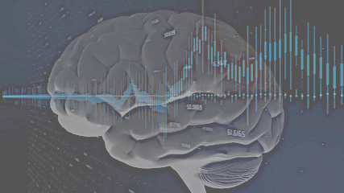
Citations
Alexandre Gramfort, Martin Luessi, Eric Larson, Denis A. Engemann, Daniel Strohmeier, Christian Brodbeck, Roman Goj, Mainak Jas, Teon Brooks, Lauri Parkkonen, and Matti S. Hämäläinen. MEG and EEG data analysis with MNE-Python. Frontiers in Neuroscience, 7(267):1–13, 2013. doi:10.3389/fnins.2013.00267. Alexandre Gramfort, Martin Luessi, Eric Larson, Denis A. Engemann, Daniel Strohmeier, Christian Brodbeck, Lauri Parkkonen, and Matti S. Hämäläinen. MNE software for processing MEG and EEG data. NeuroImage, 86:446–460, 2014. doi:10.1016/j.neuroimage.2013.10.027.
Arns, M., Etkin, A., Hegerl, U., Williams, L. M., DeBattista, C., Palmer, D. M., Fitzgerald, P. B., Harris, A., deBeuss, R., & Gordon, E. (2015). Frontal and rostral anterior cingulate (rACC) theta EEG in depression: implications for treatment outcome?. European neuropsychopharmacology : the journal of the European College of Neuropsychopharmacology, 25(8), 1190–1200.
Chesnut, M., Harati, S., Paredes, P., Khan, Y., Foudeh, A., Kim, J., Bao, Z., & Williams, L. M. (2021). Stress Markers for Mental States and Biotypes of Depression and Anxiety: A Scoping Review and Preliminary Illustrative Analysis. Chronic stress (Thousand Oaks, Calif.), 5, 24705470211000338. https://doi.org/10.1177/24705470211000338
HAMILTON M. (1960). A rating scale for depression. Journal of neurology, neurosurgery, and psychiatry, 23(1), 56–62. https://doi.org/10.1136/jnnp.23.1.56
Jaworska, N., Blier, P., Fusee, W., & Knott, V. (2012). α Power, α asymmetry and anterior cingulate cortex activity in depressed males and females. Journal of psychiatric research, 46(11), 1483–1491. https://doi.org/10.1016/j.jpsychires.2012.08.003
Korb, A. S., Cook, I. A., Hunter, A. M., & Leuchter, A. F. (2008). Brain electrical source differences between depressed subjects and healthy controls. Brain topography, 21(2), 138–146. https://doi.org/10.1007/s10548-008-0070-5
Lyon, A., Mincholé, A., Martínez, J. P., Laguna, P., & Rodriguez, B. (2018). Computational techniques for ECG analysis and interpretation in light of their contribution to medical advances. Journal of the Royal Society, Interface, 15(138), 20170821.
Pascual-Marqui, R. D., Lehmann, D., Koukkou, M., Kochi, K., Anderer, P., Saletu, B., Tanaka, H., Hirata, K., John, E. R., Prichep, L., Biscay-Lirio, R., & Kinoshita, T. (2011). Assessing interactions in the brain with exact low-resolution electromagnetic tomography. Philosophical transactions. Series A, Mathematical, physical, and engineering sciences, 369(1952), 3768–3784. https://doi.org/10.1098/rsta.2011.0081
Pizzagalli D. A. (2011). Frontocingulate dysfunction in depression: toward biomarkers of treatment response. Neuropsychopharmacology : official publication of the American College of Neuropsychopharmacology, 36(1), 183–206. https://doi.org/10.1038/npp.2010.166
Walter, W. G., & Dovey, V. J. (1944). ELECTRO-ENCEPHALOGRAPHY IN CASES OF SUB-CORTICAL TUMOUR. Journal of neurology, neurosurgery, and psychiatry, 7(3-4), 57–65. https://doi.org/10.1136/jnnp.7.3-4.57
Williams, L. M., Rush, A. J., Koslow, S. H., Wisniewski, S. R., Cooper, N. J., Nemeroff, C. B., Schatzberg, A. F., & Gordon, E. (2011). International Study to Predict Optimized Treatment for Depression (iSPOT-D), a randomized clinical trial: rationale and protocol. Trials, 12, 4. https://doi.org/10.1186/1745-6215-12-4
World Health Organization. Institute of Health Metrics and Evaluation. Global Health Data Exchange (GHDx). http://ghdx.healthdata.org/gbd-results-tool?params=gbd-api-2019-permalink/d780dffbe8a381b25e1416884959e88b (Accessed 1 May 2021).

